Slide 1
Predicting Prescription Medicine
Authors:
Nakayiza Shamim - 2024/HD05/21950U
Zindazed Abdshahd Kasauli -2024/HD05/21948U

Slide 2
Background
Poor prescription of medicines has led to issues like:
High rate of drug expiries as doctors tend to only prescribe medicines known to them, low sales since the unknown medicines to doctors are not sold to patients who need them.
In Uganda, AI is currently being applied in other health-related areas, such as disease detection.

Slide 3
Problem
Poor prescription of medicines in hospitals leading to high rates of expiries hence business losses.

Slide 4
Gaps in related work
In Uganda, AI is currently being applied in other health-related areas, such as disease detection and not prescriptions for example:
Makerere University researchers are working on AI tools for detecting diseases like malaria
The international solutions don't favor Africans due to genetic, environmental, and socio-economic differences

Slide 5
Objective
To develop a predictive model that helps in:
Predicting the most appropriate medicines based on diagnosis and age range.

Slide 6
Research Questions
Is the available data able to make the right prescriptions?
Are the available data fields helping in optimizing pharmacy inventory management to reduce drug expiries?
Are the available data fields able to predict alternative medicines based on diagnosis and age group.
Is the data required readily available, clean, and well transformed for the research?

Slide 7
Solution
To develop a machine learning model based on an African/Ugandan way of prescription. It will be trained using African/Ugandan data for prescription.

Slide 8
Methodology
The kind of learning used is supervised learning.
The kind of data used is classification data in a tabular format.
Data Engineering
Feature Engineering
Modeling
Model Evaluation
Explainable AI

Slide 9
Data Engineering
Understanding the data
Data Collection
Data Cleaning
Data Transformation

Slide 10
Data Collection
Data was collected from our workplace.
https://docs.google.com/spreadsheets/d/1j2BV3bul7ItkQYDPs5n8NO0dWzgyR_XXRxGJykl9NGo/edit?gid=1175932089#gid=1175932089
It was extracted from a database that holds client medical medical records.

Slide 11
Understanding the data.
Here we looked at the structure of the data, identified fields that will be of importance based on the amount of data they have.
We had 88090 rows and 9 columns.
The Key Columns include Diagnosis, Age and Product.

Slide 12
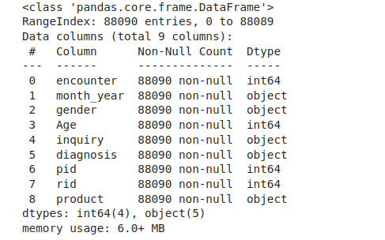
Data info()

Slide 13
Data cleaning
Handling Missing Data
According to this phase of understanding data, we found out that data is not clean.
5 columns had none meaningful headings, hence dropped. And remained with 4 columns.
We checked for null values in records and we did not have any.
After cleaning, we remained with 19396 rows and 4 columns.

Slide 14
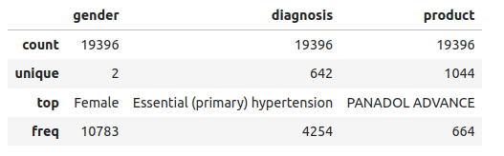
Descriptive statistics for categorical columns

Slide 15
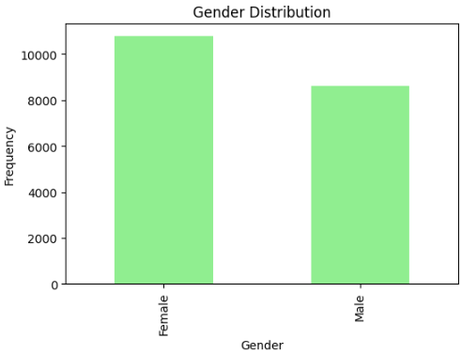
Exploratory Data Analysis
Univariate Analysis
Plotting a graph of gender distribution
Trends: More Females than males

Slide 16
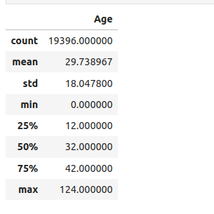
Univariate Analysis

Slide 17
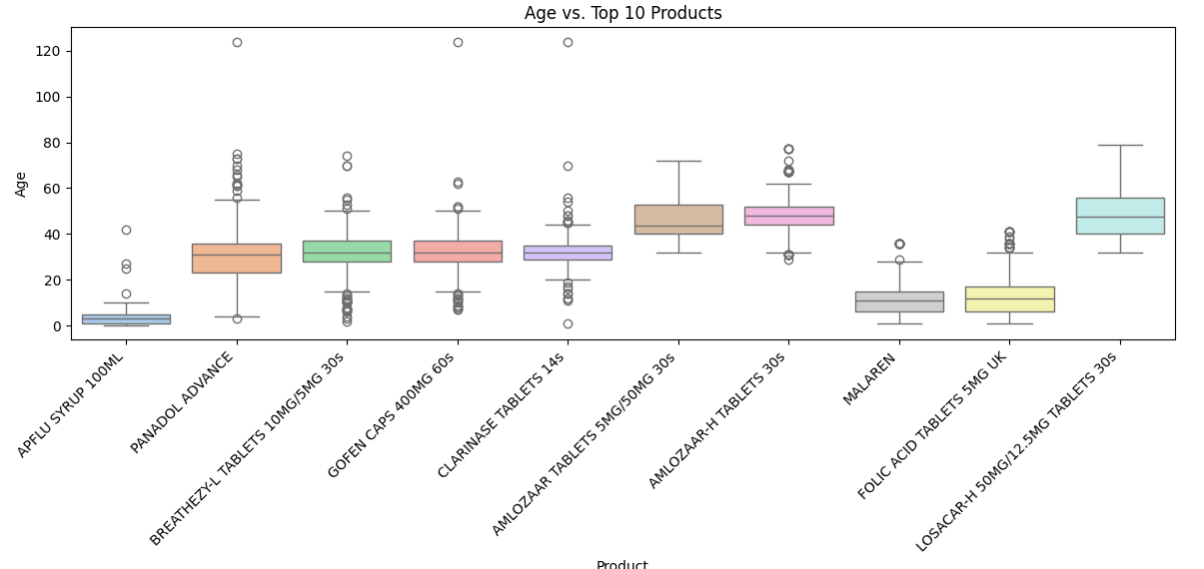
Bivariate

Slide 18
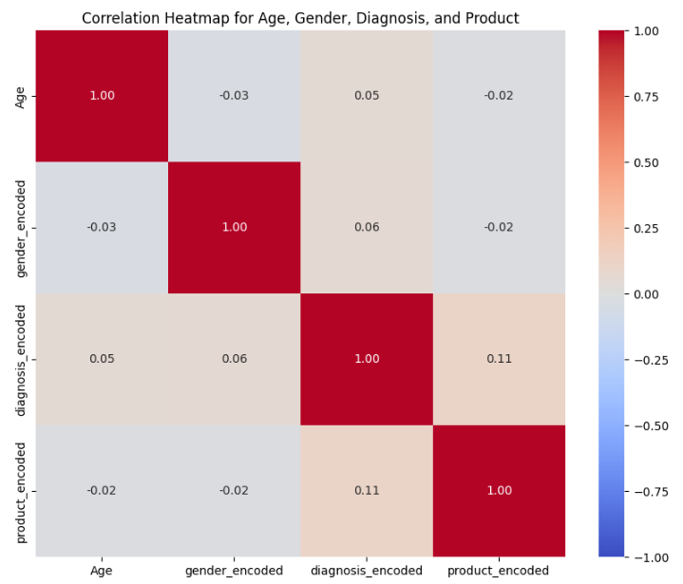
Multivariate
There is a small correlation generally between the four key fields.

Slide 19
Feature Engineering
We ensured that data is in the right format required. This was archived by encoding it using the label encoder.
We got rid of diagnosis which was poorly structured like those with commas.
Classes with less data were removed.

Slide 20
Modeling
Data was split into 80% training and 20% testing.

Slide 21
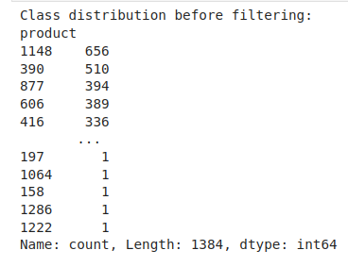
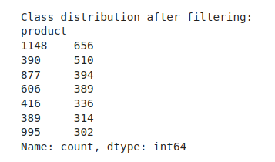
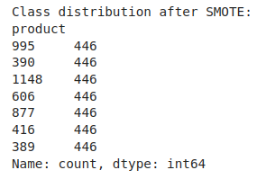
Feature Engineering

Slide 22
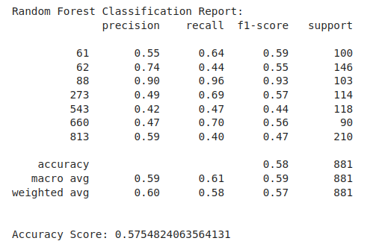
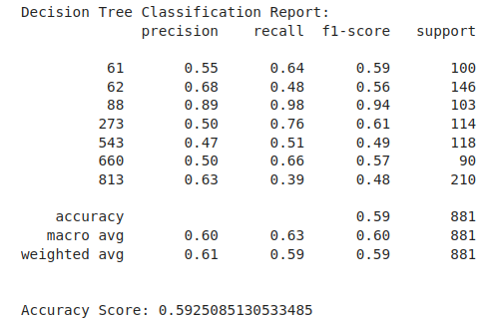
Modeling

Slide 23
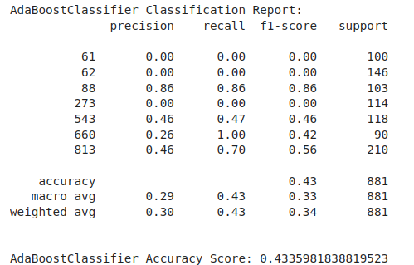
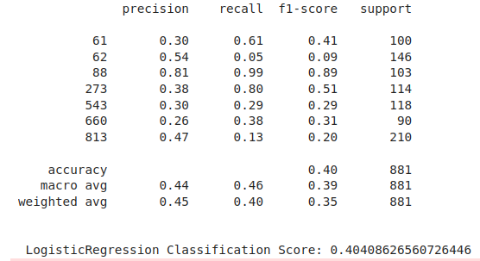
Models’ results cont’d

Slide 24
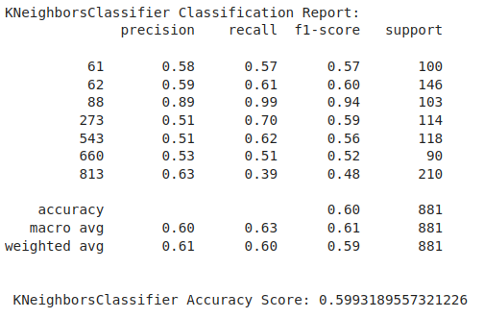
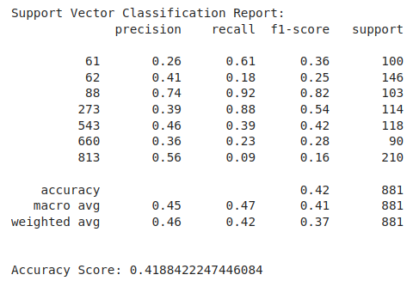
Models’ results cont’d

Slide 25
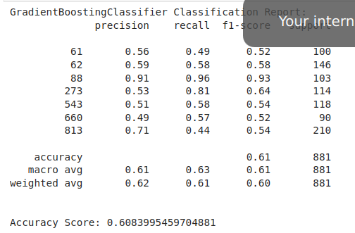
Models’ results cont’d

Slide 26
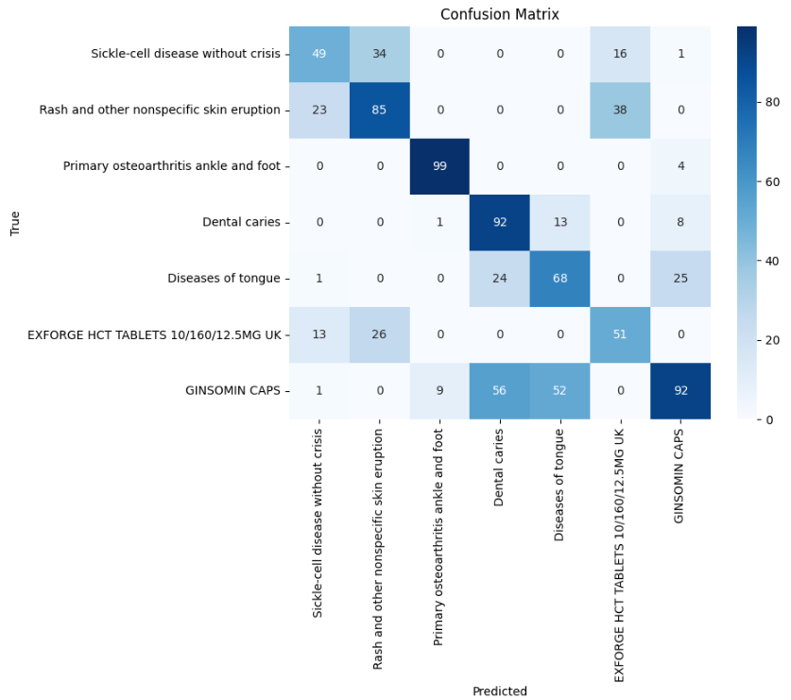
Performance Measurement.

Slide 27
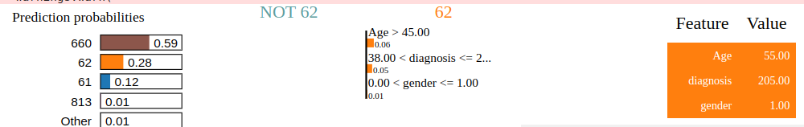
LIME
NOT 62: The mostly predicted.
Age and Diagnosis influence class 62 most.

Slide 28
Conclusion
Improving the performance of a Gradient Boosting model performing at 60%

Slide 29
Future Work
Improve model
Deploy Model
Maintain Model

